Slide 1
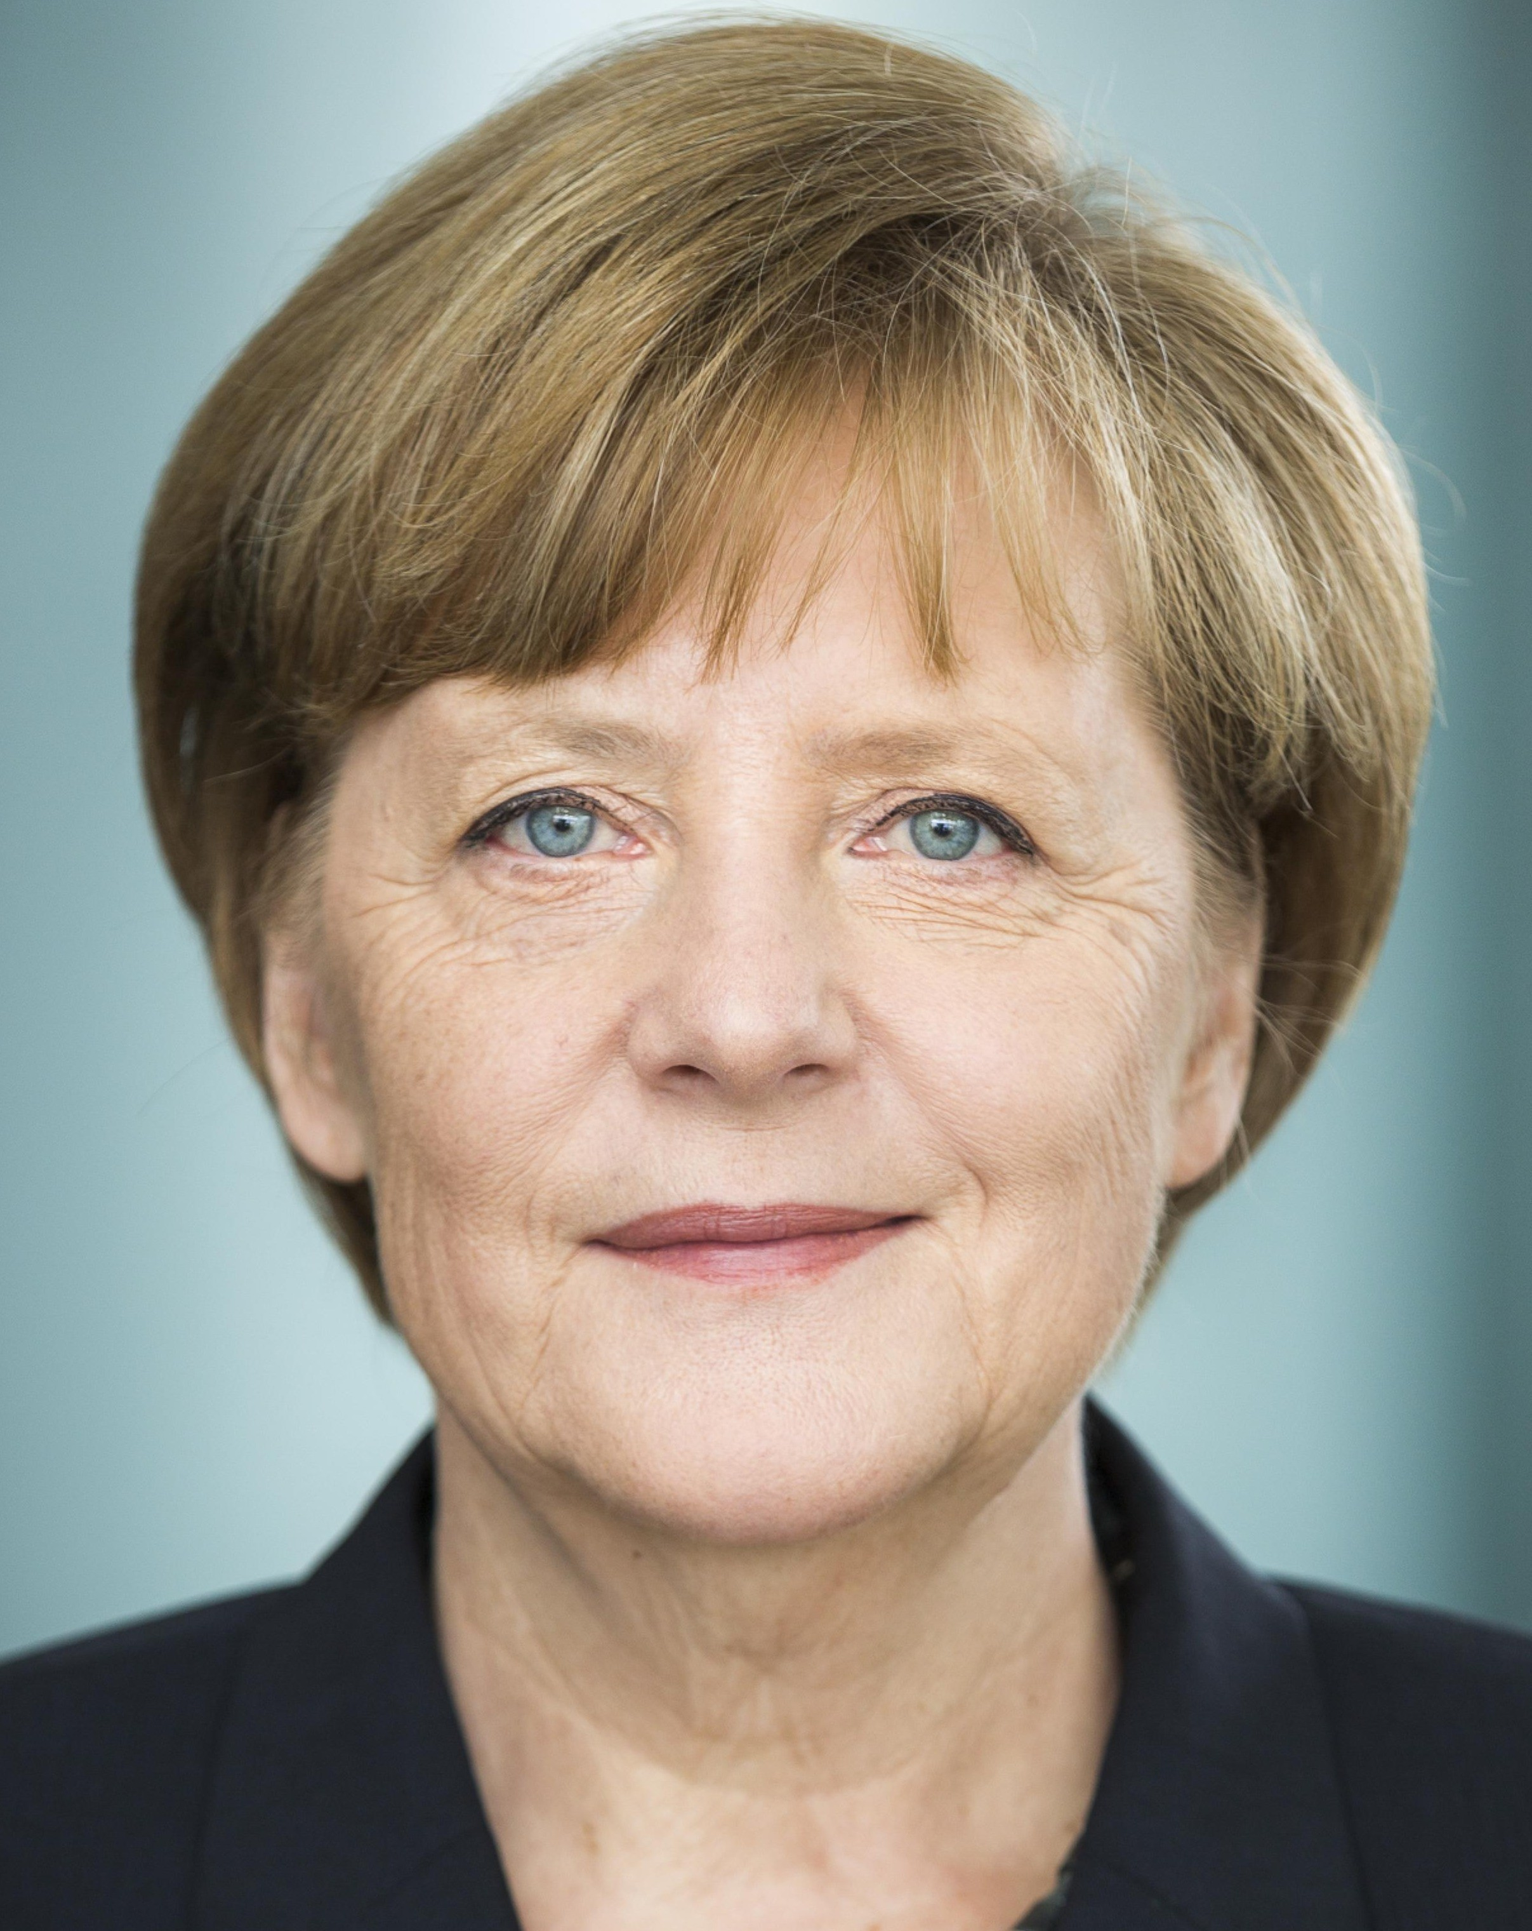
ANGELA MERKEL
BY:NAJAM ALI ABASS

Slide 2
INTRODUCTION
ANGELA DOROTHEA MERKEL(BORN JULY 17,1954)
BORN IN HAMBURG, WEST GERMANY)
SHE IS A GERMAN POLITICIAN
SERVING AS THE CHANCELLOR OF GERMANY SINCE 2005.

Slide 3
PERSONAL LIFE
EARNED DOCTORATE AS PHYSICAL CHEMIST
OLDEST CHILDREN
MARRIED TWICE
HAS NO CHILDREN
FERVENT FOOTBALL FAN

Slide 4
POLITICAL CAREER
Merkel appeared in politics during 1989
Stood for election in 1990
Became Minister Environment and Nuclear Safety
Joined CDU (Christian Democratic Union)
First Chairperson of CDU (April,2000)

Slide 5
POWERFUL POSITIONS
MOST POWERFUL WOMEN IN EUROPE FOR PAST 5 YEARS
FIRST EVER GERMAN FEMALE CHANCELLOR
LEADER OF EUROPE’S BIGGEST ECONOMY

Slide 6
CHANCELLORSHIP
ON NOVEMBER 22, 2005 SHE TOOK CHANCELLOR OFFICE
FIRST TWO TERMS WITH EURO DEBT CRISIS
MIGRANT CRISIS

Slide 7
HONORS AND AWARDS
Dame Cross Award of Order Merit Italian Republic
Dame Cross Award of Order Merit German Republic
Presidential Medal of freedom (United States)
Presidents Medal
Honorary Doctorate from Hebrew University
Honorary Doctorate from University of leipzig

Slide 8
THE END

